Slide 1
Chapter 2.1:
Binary Adder– Subtractor

Slide 2
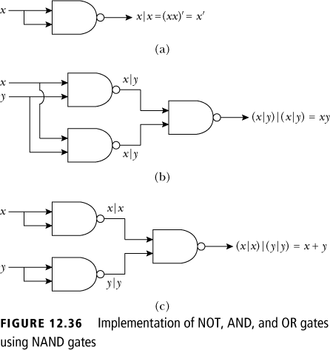
Logical Gates and Combinatorial Circuits
A NOT gate can be implemented using a NAND gate (a).
An AND gate can be implemented using NAND gates (b).
An OR gate can be implemented using NAND gates (c).

Slide 3
Logical Gates and Combinatorial Circuits
Any circuit which is designed by using NOT, AND, and OR gates can also be designed using only NAND gates.
Any circuit which is designed by using NOT, AND, and OR gates can also be designed using only NOR gates.

Slide 4
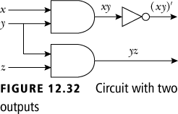
Adders: Logical gates to add two numbers
We need to use a circuit with more than one output, which clearly more powerful than a Boolean expression.

Slide 5
How to add binary numbers
Consider adding two 1-bit binary numbers x and y
  0+0 = 0
  0+1 = 1
  1+0 = 1
  1+1 = 10
Carry is x AND y
Sum is x XOR y
The circuit to compute this is called a half-adder
x | y | Carry | Sum
0 | 0 | 0 | 0
0 | 1 | 0 | 1
1 | 0 | 0 | 1
1 | 1 | 1 | 0

Slide 6
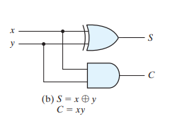

= s (sum)
c (carry)
x | y | s | c
1 | 1 | 0 | 1
1 | 0 | 1 | 0
0 | 1 | 1 | 0
0 | 0 | 0 | 0

Slide 7
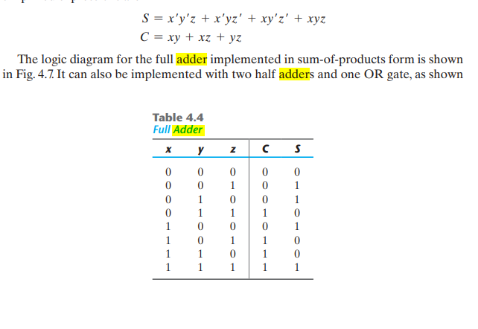
Full Adder

Slide 8
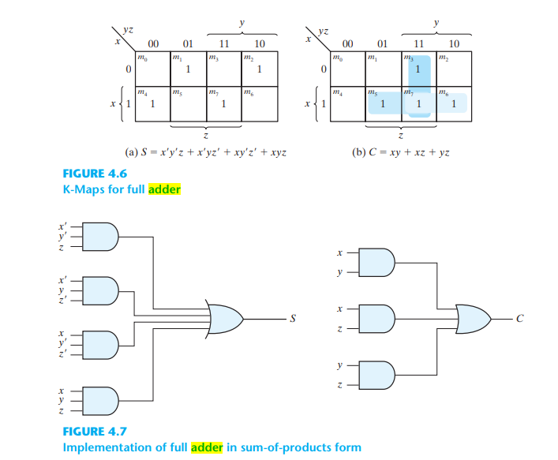
Full Adder
C= XY’Z+X’YZ+XY

Slide 9
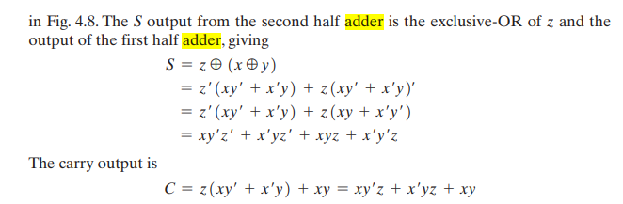
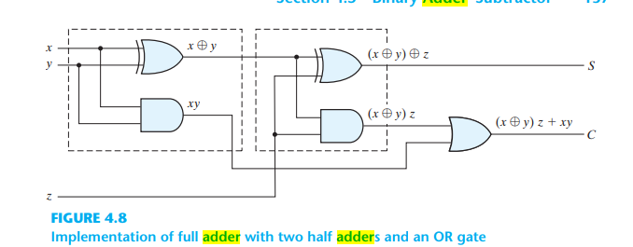
Full Adder

Slide 10
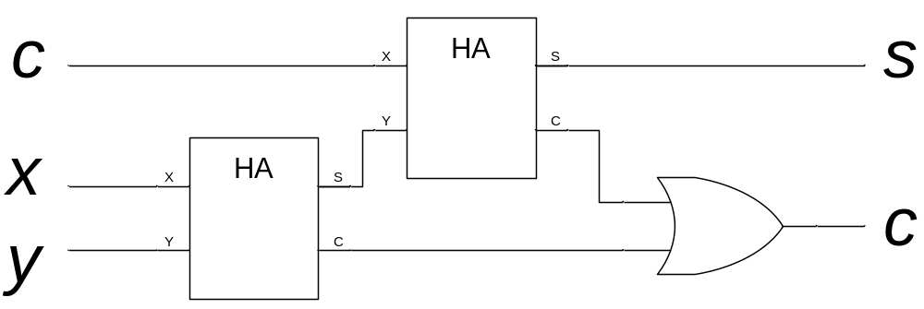
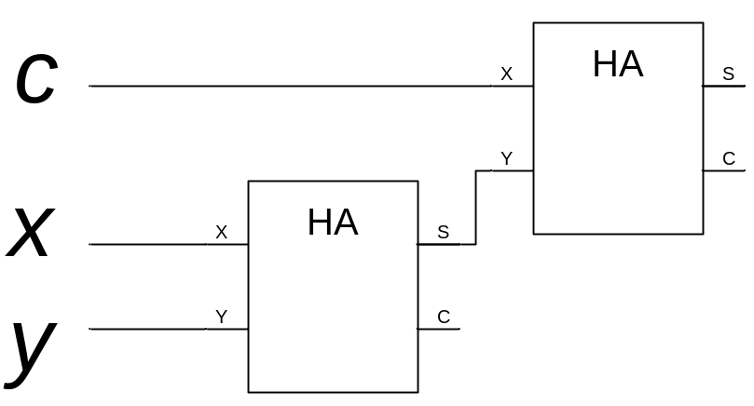
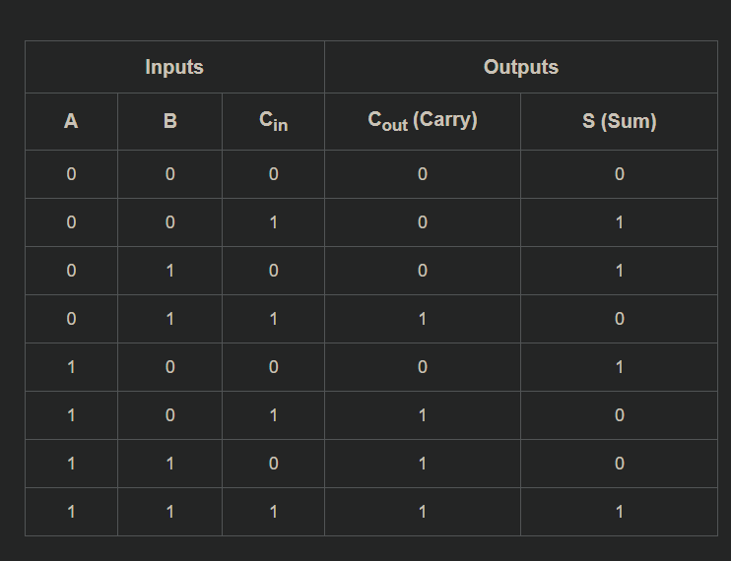
A full adder is a circuit that accepts as input thee bits x, y, and c, and produces as output the binary sum cs of a, b, and c.

Slide 11
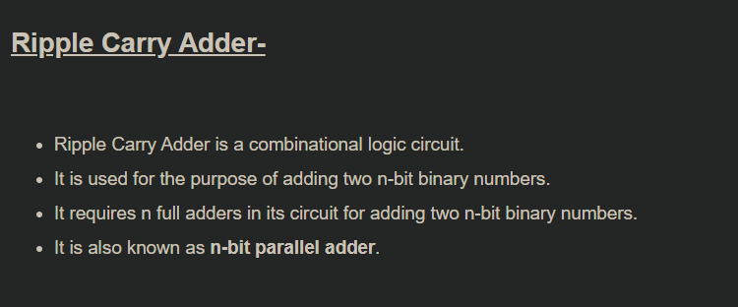
Adding bigger binary numbers

Slide 12
Adding bigger binary numbers
We can use a half-adder and full adders to compute the sum of two Boolean numbers
1
0
0
1 1 0 0
+ 1 1 1 0
?
0
1
0

Slide 13
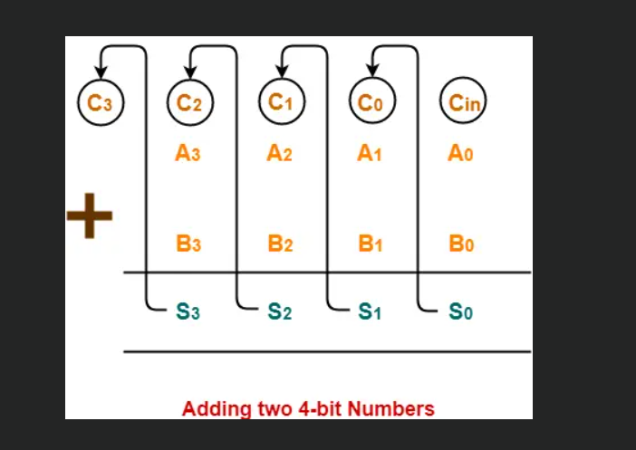
4-bit Ripple Carry Adder

Slide 14
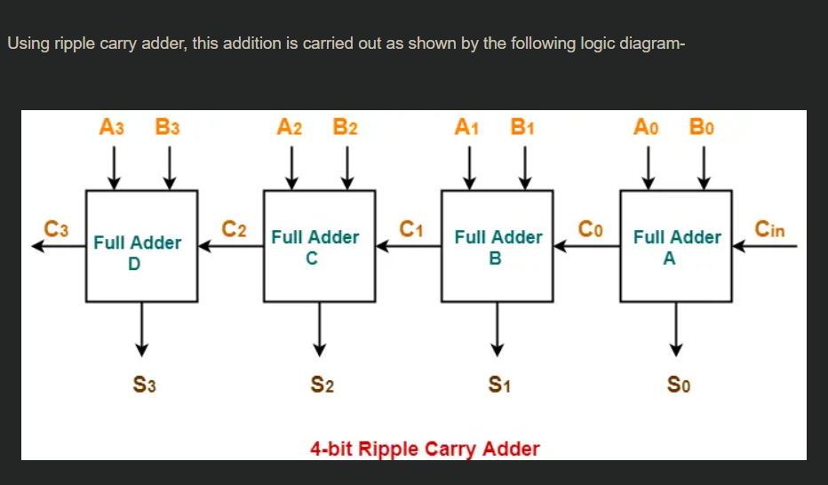

4-bit Ripple Carry Adder

Slide 15
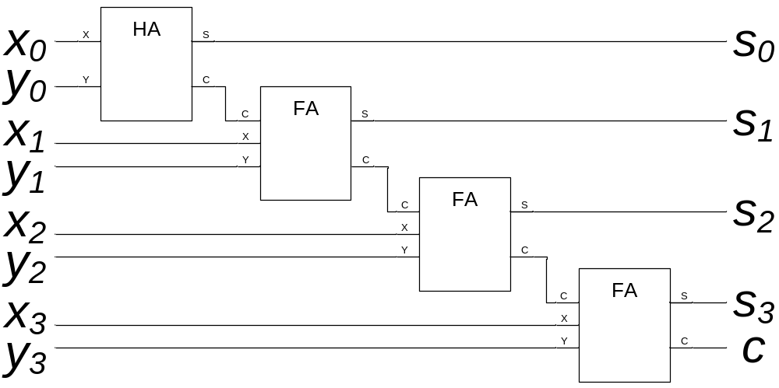
Adding bigger binary numbers
Just chain one half adder and full adders together,
e.g., to add x=x₃x₂x₁x₀ and y=y₃y₂y₁y₀ we need:

Slide 16
Adding bigger binary numbers
A half adder has 4 logic gates
A full adder has two half adders plus a OR gate
  Total of 9 logic gates
To add n bit binary numbers, you need 1 HA and n-1 FAs
To add 32 bit binary numbers, you need 1 HA and 31 FAs
  Total of 4+9*31 = 283 logic gates
To add 64 bit binary numbers, you need 1 HA and 63 FAs
  Total of 4+9*63 = 571 logic gates

Slide 17
More about logic gates
To implement a logic gate in hardware, you use a transistor
Transistors are all enclosed in an “IC”, or integrated circuit
The current Intel Pentium IV processors have 55 million transistors!

Slide 18
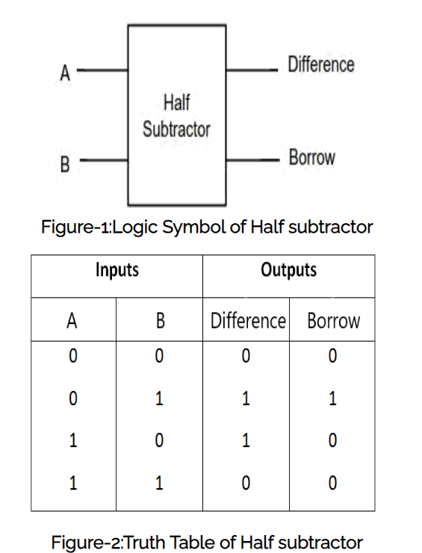
Half Subtractor

Slide 19
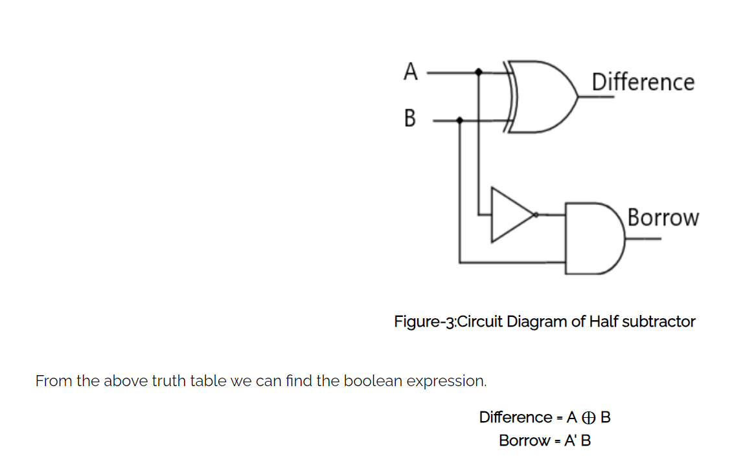
Half Subtractor

Slide 20
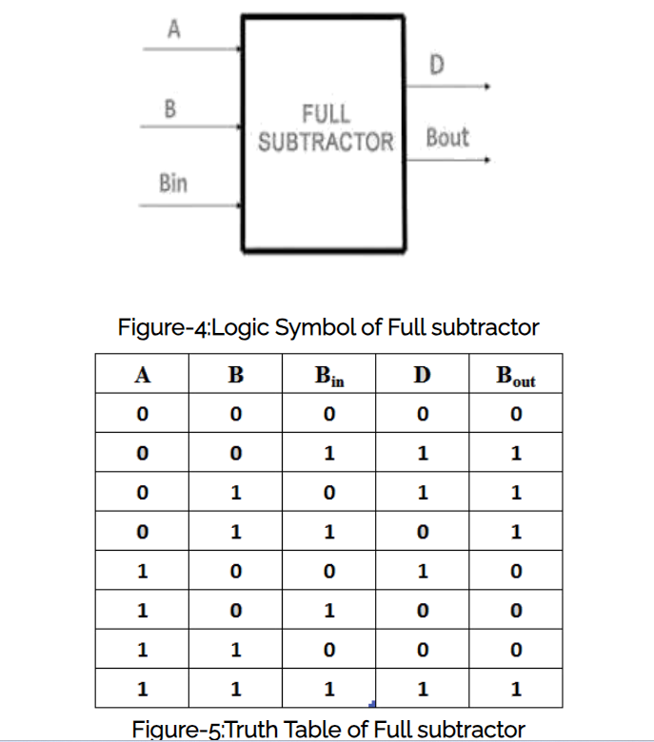
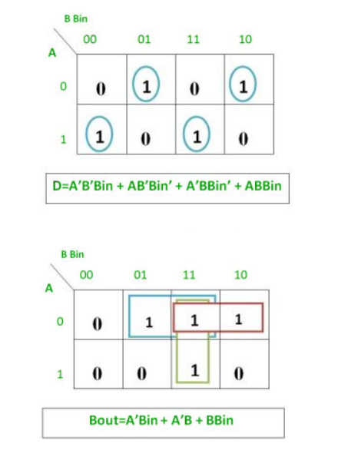
Full Subtractor

Slide 21
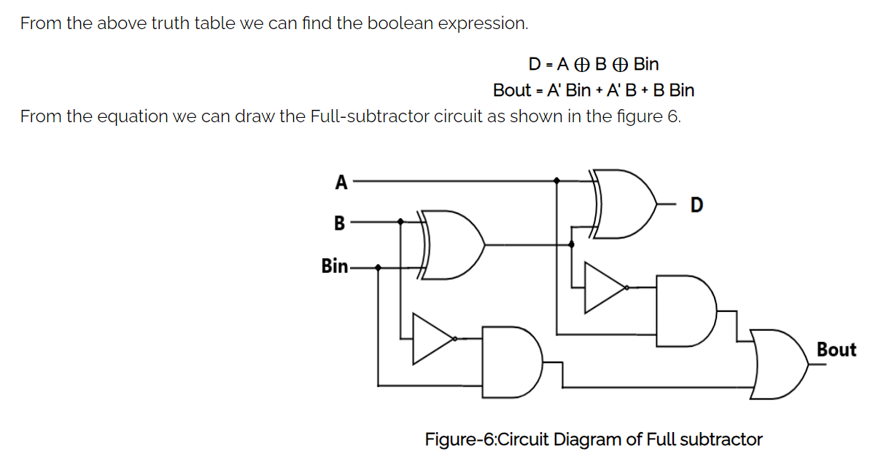
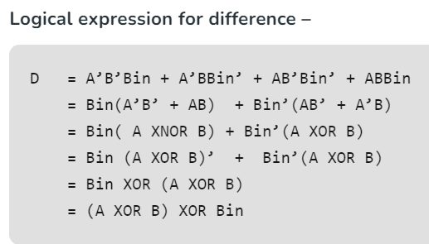
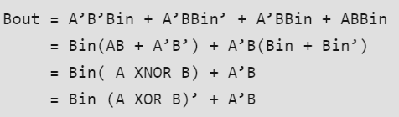
Full Subtractor
Notes:
https://www.geeksforgeeks.org/full-subtractor-in-digital-logic/?ref=lbp

Slide 22
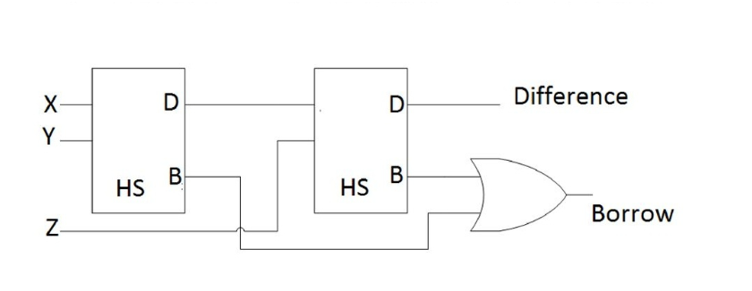
Full Subtractor

Slide 23
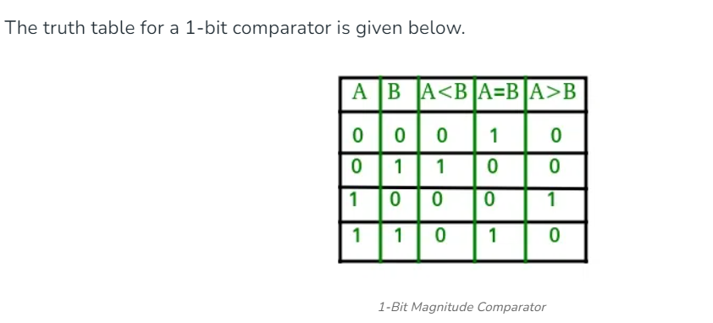
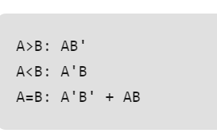
Magnitude Comparator

Slide 24
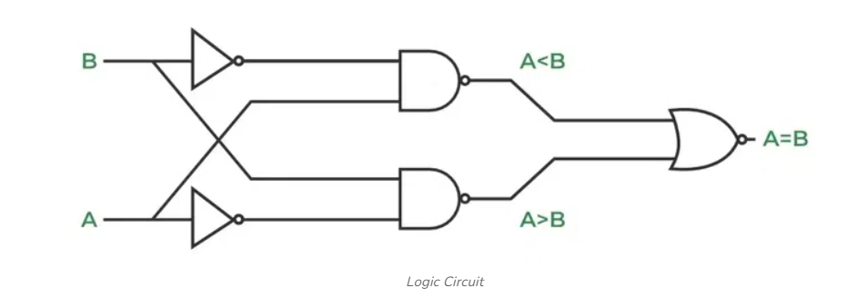
Magnitude Comparator
Notes:
https://www.geeksforgeeks.org/magnitude-comparator-in-digital-logic/

Slide 26
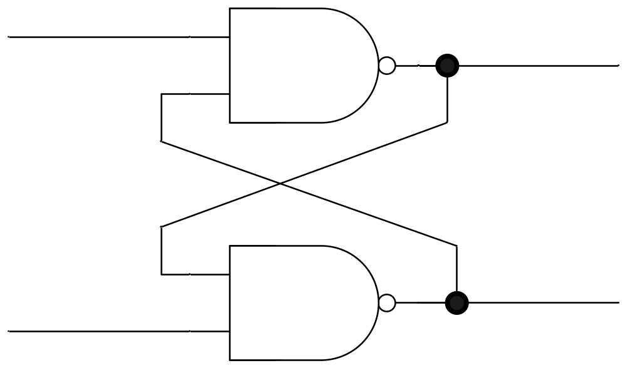
Flip-flops
Consider the following circuit:
What does it do?
R | S | Function
1 | 0 | Reset
0 | 1 | Set
1 | 1 | Hold
0 | 0 | 1/1
R
Q
Q’
S
It holds a single bit of memory.

Slide 27
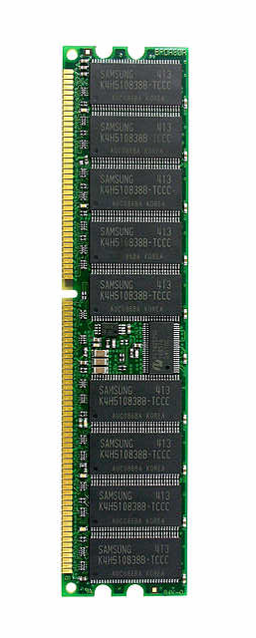
Memory
A flip-flop holds a single bit of memory
  The bit “flip-flops” between the two NAND gates
In reality, flip-flops are a bit more complicated
  Have 5 (or so) logic gates (transistors) per flip-flop
Consider a 1 Gb memory chip
  1 Gb = 8,589,934,592 bits of memory
  That’s about 43 million transistors!
In reality, those transistors are split into 9 ICs of about 5 million transistors each

